Slide 1
Shop Management System
Saud Nasir (22P-9227)
Abdullah Bilal (22P-9248)
Faran Ahmad (22P-9249)

Slide 2
Introduction
Welcome to our Shop Management System! Our platform provides a convenient and efficient way for users to manage their shop, whether it's a small business or a large enterprise.
With our system, users can register and login to their accounts securely. Once logged in, they can easily add new products to their inventory, update existing product details, and remove products that are no longer available.
Our system also simplifies the sales process, allowing users to track and manage product sales effortlessly. By providing a user-friendly interface and powerful management tools, we aim to streamline shop operations and help businesses thrive.
Experience the convenience and efficiency of our Shop Management System today!

Slide 3




Technologies Used

Slide 4
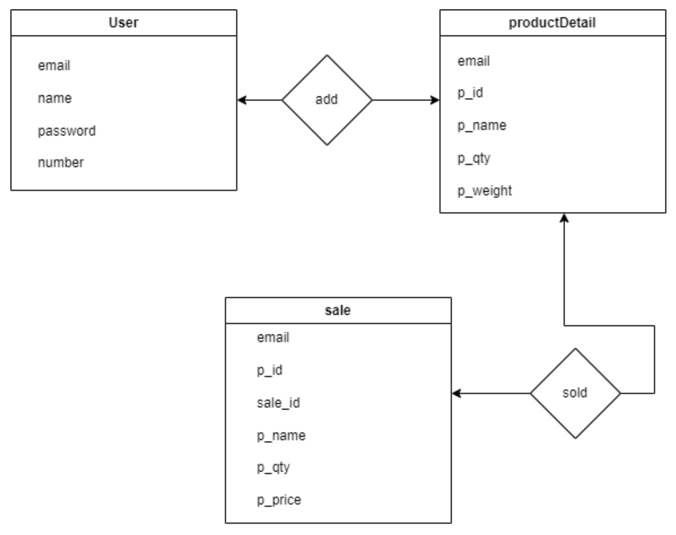
ERD

